Slide 1

Mojito
Carpool
JavaScript Applications Teamwork

Slide 2
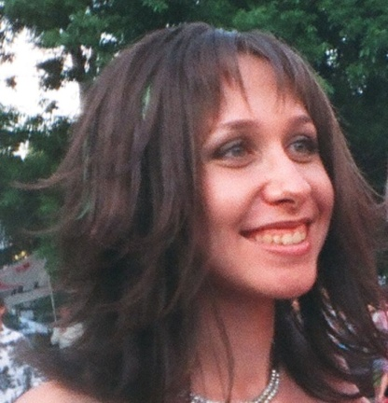

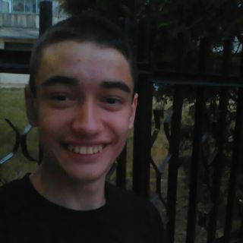

Mojito Team
Stefan Yovchev
Petya Kostova
Ilian Bratanov
stefan.yovchev.39
pepsi_555
ilian82
Nikolay Karagyozov
Svetlozar Stoichkov
newmast
sv.stoichkov

Slide 3
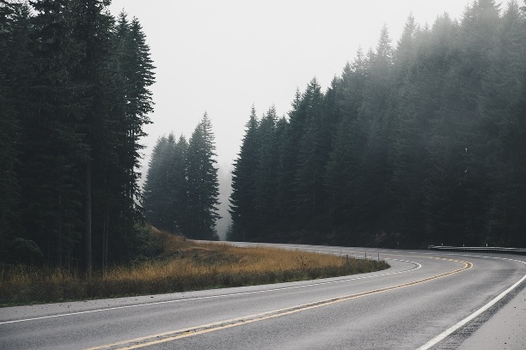
Application description
Registration
Creating trips
Participation in travel
Used:
Telerik Backend Services
jQuery
Bootstrap
OOCSS
REST API
Google Maps API

Slide 4
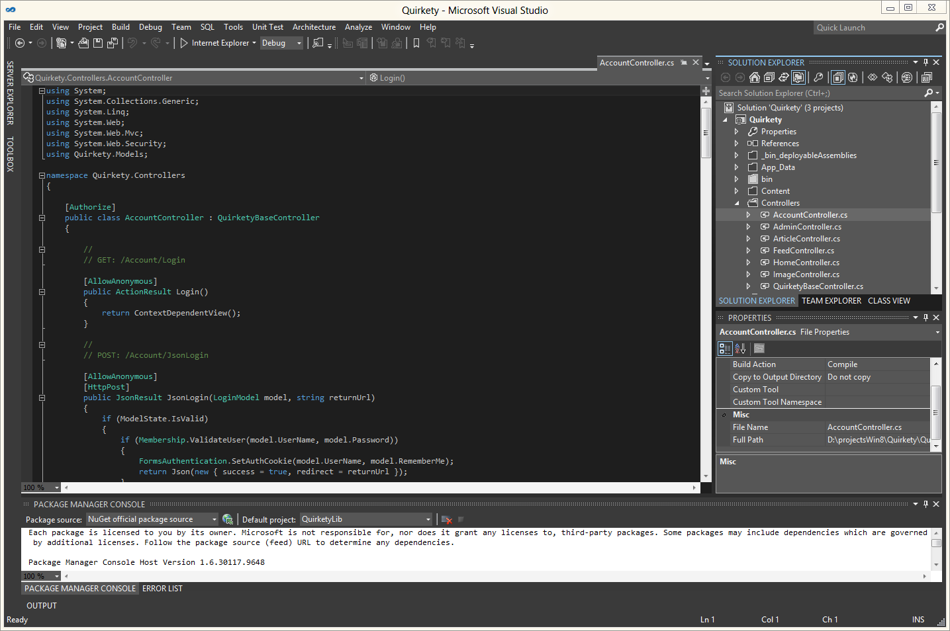
Code Demo

